Slide 1
DLD
Department of Computer Science & IT
Hazara University Mansehra

Slide 2
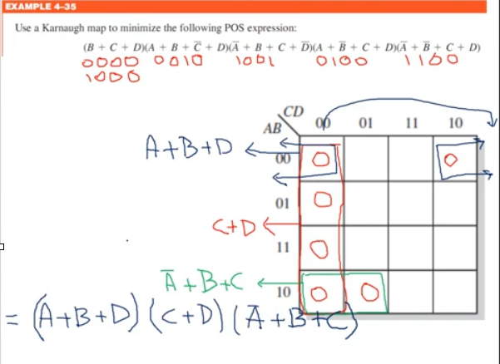
Simplification of POS Expression using K-Map

Slide 3
SOP to POS Conversion (Vice Versa) Using K-Map

Slide 4
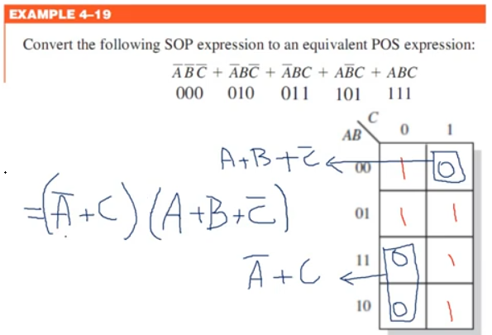

Slide 5
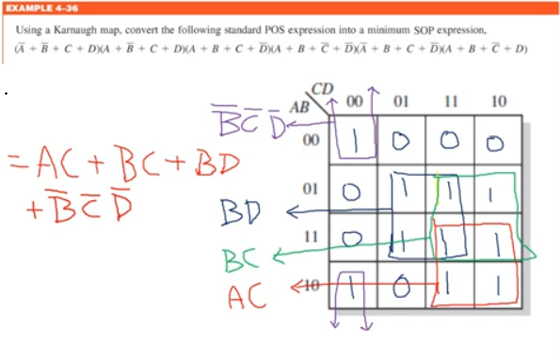

Slide 6
“Don’t Care” Conditions in k-Map

Slide 7
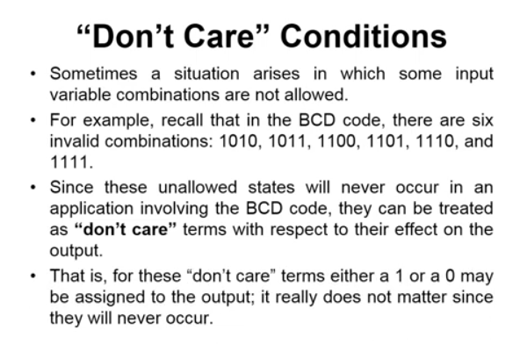

Slide 8
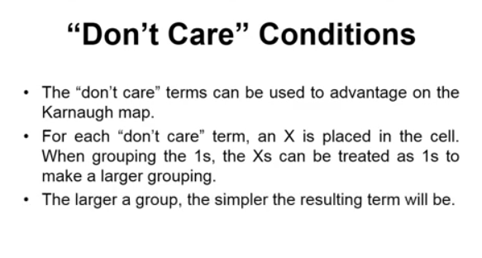

Slide 9
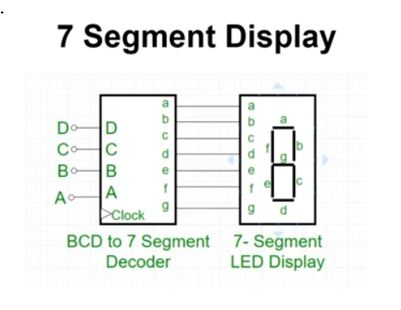

Slide 10
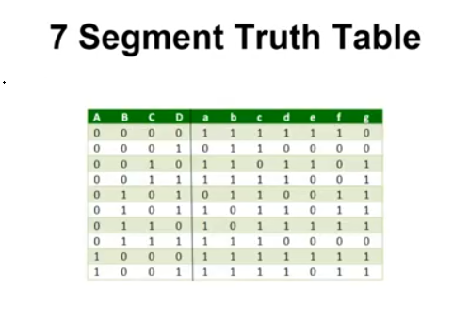

Slide 11
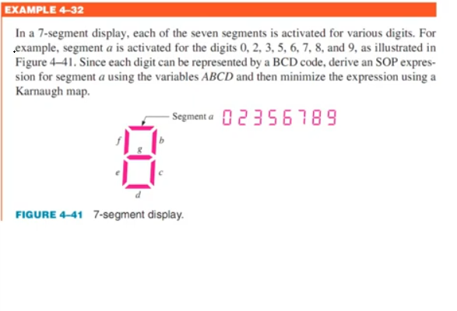

Slide 12
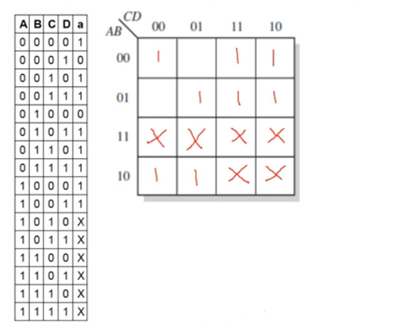

Slide 13
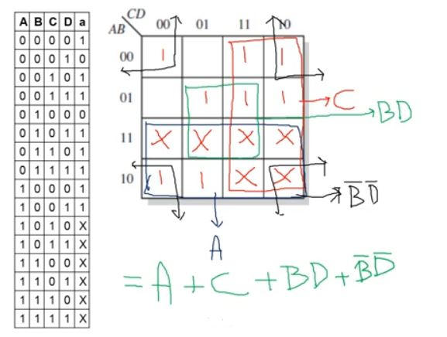

Slide 14
5 Variable Karnaugh Map

Slide 15
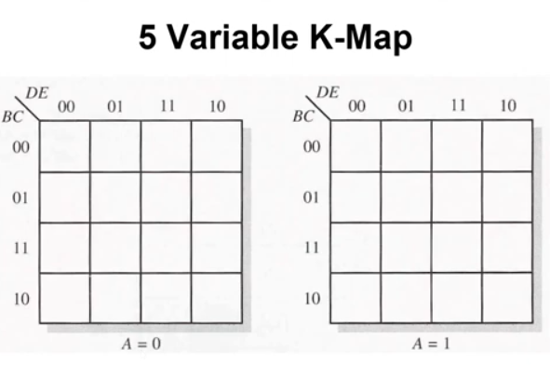

Slide 16
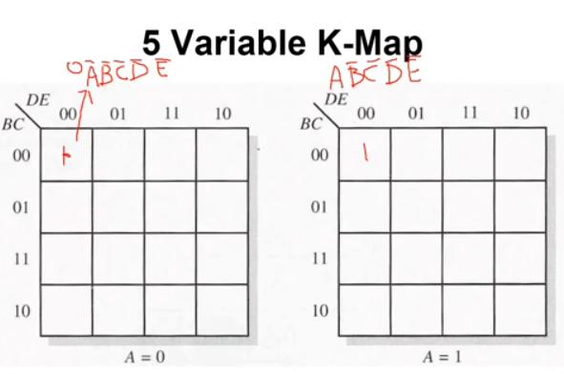

Slide 17
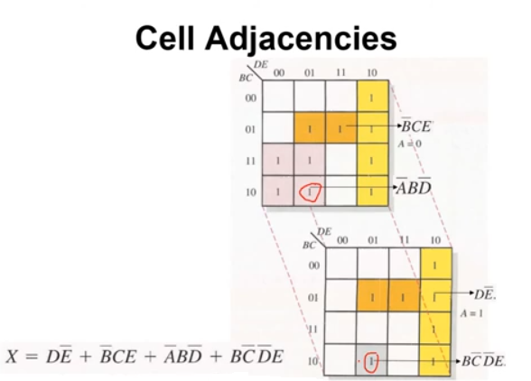

Slide 18
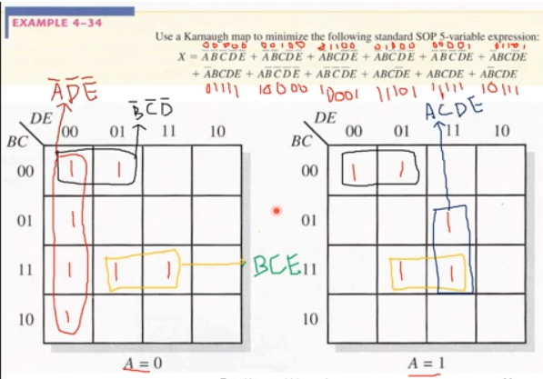

Slide 19
